Slide 1

Educational Loans Repayment
Miners Group

Slide 2
Project Name:
Educational Loans Repayment
Group:
Miners
Team Members:
Heba Saad
HebatAllah Zakaria
Usama Atteya
Yehia Atef Dorgham

Slide 3
Use Case & Problem Description
Most students during their college education incur significant amount of debt, their debt can vary from one college to the other also their repayment rates, many factors influence the debt and its repayment as well.
In an effort to make educational investments less speculative, the US Department of Education has matched information from the student financial aid system with federal tax returns to create the College Scorecard dataset.
Our objective is to use this dataset to predict students’ ability to repay their educational loans by exploring different institutional features.

Slide 4
Benefit for End users
The proposed predictive model will aid the decision makers of the US government to minimize the risk of bad debts.
Also it will put the power in the hands of students and families to compare colleges and see a better vision on how many graduates at a particular school are able to pay back their student loans.
The ability to pay back students loans is generally a good indicator of how well colleges and universities are preparing their graduates for the job market.

Slide 5
Data Sources
US Department of Education (https://collegescorecard.ed.gov/data/)
College Scorecard data are provided through federal reporting from institutions, data on federal financial aid, and tax information.
These data provide insights into the performance of schools that receive federal financial aid dollars, and the outcomes of the students of those schools.

Slide 6
Overall model structure & workflow

Slide 7
Tools & Platforms
Azkaban
My SQL Database
Sqoop
Hadoop ( HDFS )
PySpark
Jupyter
Flask
GitHub repository

Slide 8
Data Exploration and Preparation
Correlation
Null values detection
Outliers detection
Handling data encrypted or masked due to privacy issue
Handling Null/Nan values (Imputation with Mean / Median)
Categorical variables encoding (One-Hot Encoder)

Slide 9
Modeling Techniques
The following regression models were selected and assessed:
Multiple Linear Regression
Ridge
Lasso
XGBoost
SVR ( with two kernels : Linear , and RBF )
Error Metrics
MSE
R2

Slide 10
Models Assessment
Based on the above findings the best model is: XGBoost
Model | MSE Values |  | r2 score Values
 | Training Set | Tet Set | Training Set | Tet Set
XGBoost | 0.003 | 0.006 | 0.92 | 0.834
Ridge | 0.0100 | 0.0098 | 0.7428 | 0.7513
Lasso | 0.0101 | 0.0097 | 0.7401 | 0.7527
MLR | 0.0100 | 0.0097 | 0.7425 | 0.7525
SVR (Linear) | 0.0354 | 0.0355 | 0.0883 | 0.0985
SVR (RBF) | 0.0079 | 0.0394 | 0.7950 | -0.0004

Slide 11
XGBoost Model
Due to the nature of the scorecard data there’s significant amount of missing/suppressed values and outliers.
XGboost algorithm is the best model as it is invariant to outliers and can handle missing values by default, it is also has built in regularization which prevents the model from overfitting.

Slide 12
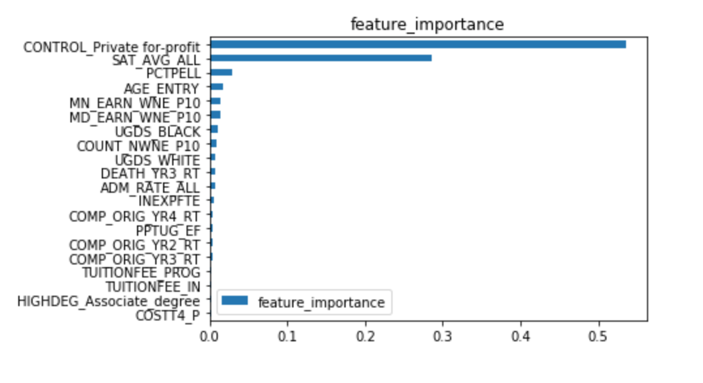
Important Features
Institute Type (Private for profit)
Average SAT Score
Percentage of Pell Students
Entry age for students

Slide 13
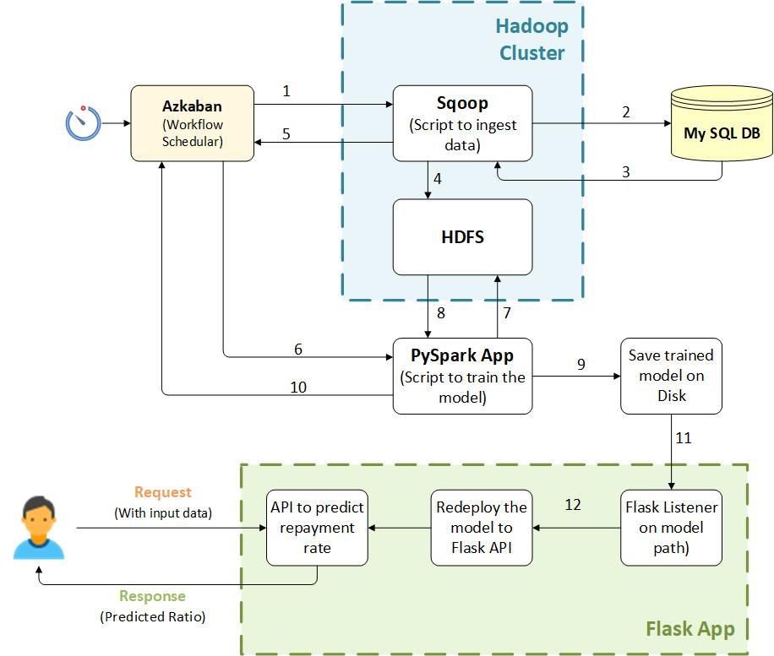
Deployment Workflow

Slide 14
Deployment Workflow
Azkaban scheduler triggers Sqoop cluster every 15 min
Sqoop cluster ingests the data from My SQL and saves it to HDFS
PySpark application (triggered by Azkaban) drills the data from HDFS, executes training using “XGBoost” and saves the model
Flask listener listen to the model updates, then redeploy the updated model to Flask API

Slide 15
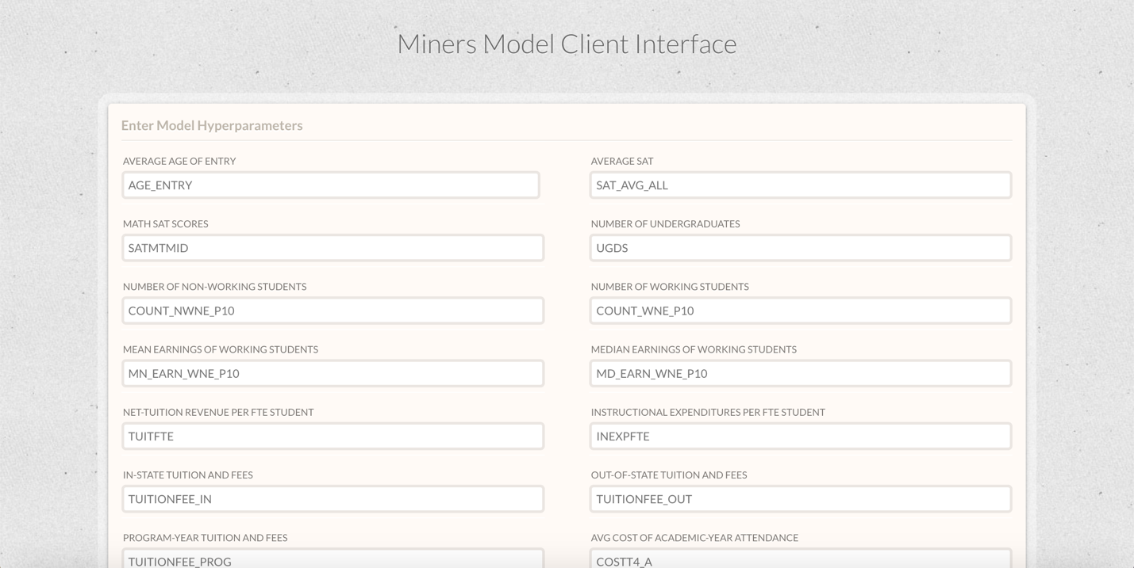
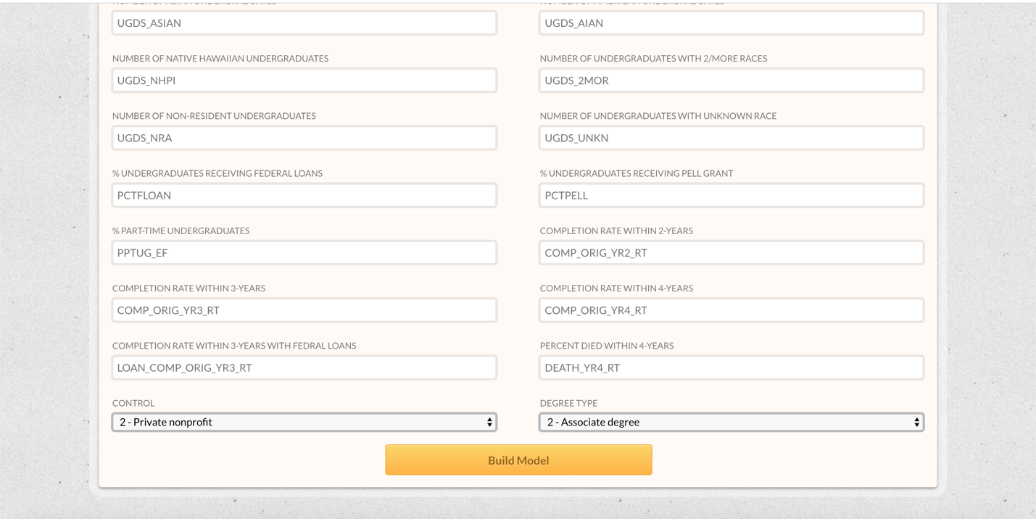
End User Application
The user fills the information about the institute in question and press on Build Models

Slide 16
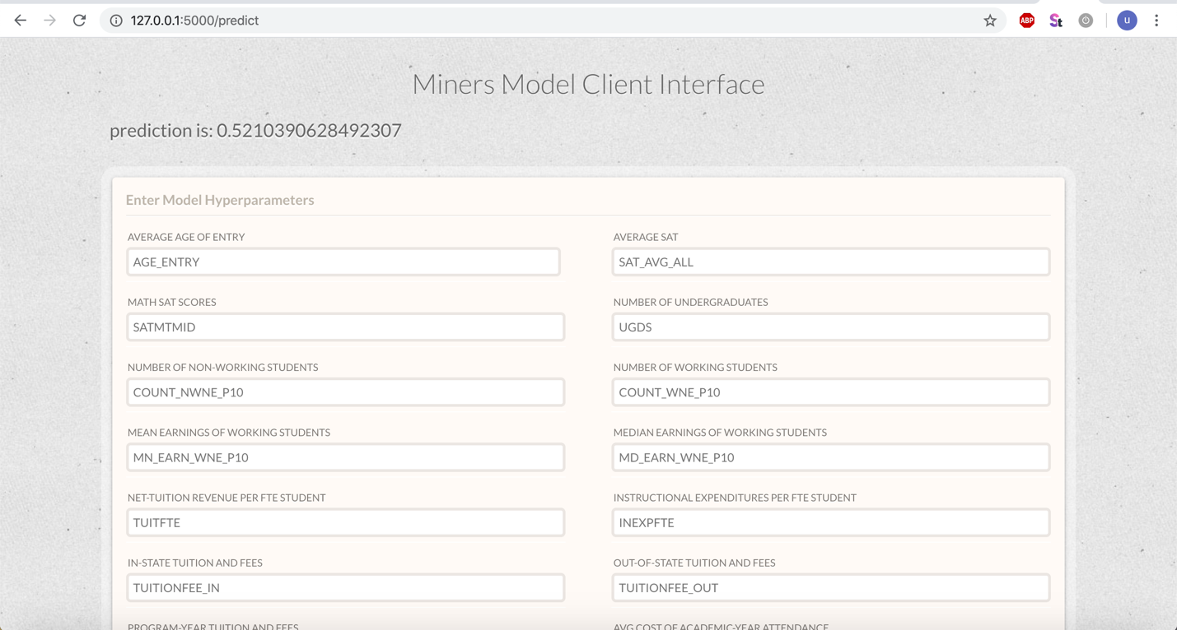
End User Application
The Flask API computes the predicted value based on our model and returns it
Then the user gets the probability of repayment
(if a student took a loan and got enrolled in this institute, the probability of repayment is the result)

Slide 17
References
https://collegescorecard.ed.gov/data/
https://www.kaggle.com/kaggle/college-scorecard
https://github.com/benhamner/us-college-scorecard
https://www.kaggle.com/apollostar/which-college-is-best-for-you/report
https://www.kaggle.com/apollostar/which-college-is-best-for-you-part2/report
https://rpubs.com/random_Island/education-loan-repayment
https://www.americanprogress.org/issues/education-postsecondary/reports/2016/12/19/295187/sharing-the-risk/

